Slide 1
JD’s Football School
FOOTBALL Activities

Slide 2
JD’s Football School Covid-19 - Risk Assessment (1)
Date: September 1st 2020
Venue 1: Sutton United FC, Gander Green Lane, SM1 2EY (3G Facility)
Venue 2: St Catherine’s Playing Fields, Grand Drive, Raynes Park, Surrey, SW20 9NA (Grass Facility)
Venue 3: School Facilities'
Assessment Scale:
Frequency: Severity: Interpretation:
Improbable occurrence 1. No Injuries 4 and below = Low Risk
Possible occurrence 2. Minor Injury 5 to 8 = Medium Risk
Occasional Occurrence 3. Major Injury. 9+ = High Risk
Frequent Occurrence 4. Major Injury to more than one person
Regular Occurrence 5. Death of one or more persons

Slide 3
Risk Assessment (2) Covid-19
Activity | What are the hazards? | Who might be affected? | Assess the Risk (Before controls) F x S = R | Controlling Action: (Prevention) | Assess the Risk (After Controls) F x S = R | Action by who? | Action by when?
Playing outdoor Football | Social Distancing Exposure to virus is increased unless players, staff and parents adhere to social distancing guidelines. | Players, Staff & Parents | 4 X 3 = 12 | Parents to remain in their car when dropping off and collecting their child. Players will be escorted from the car onto the pitch to join their designated bubble group Members of staff who are escorting the children will be in PPE Temperature checks & Hand sanitiser provided upon arrival Briefing will take place before each session Staggered breaks throughout the day including water breaks and lunch | 2 x 3 = 6 | Staff, players and parents to be reminded on a daily basis of the importance of social distancing both at our venues and outside of it. | Throughout the whole day.
Cleaning Equipment | Exposure to virus is increased unless appropriate standards of cleaning & disinfection are in operation | Players, Staff & Parents | 4 X 3 = 12 | Frequently cleaning and disinfecting all equipment and surfaces that are touched regularly particularly in areas of high usage such as toilets | 2 x 3 = 6 | Rigorous checks will be carried out by managers and all staff to ensure that the necessary procedures are being followed. | Start, Middle and end of each day.
Hand Washing | Exposure to virus is increased unless appropriate standards of hand cleaning with water/soap and hand sanitizer is maintained. | Players, Staff & Parents | 4 X 3 = 12 | Hand sanitiser to be provided before, during and after the day Soap, Warm water and disposable tissues to be provided in the toilets | 2 x 3 = 6 | Rigorous checks will be carried out by managers and all staff to ensure that the necessary procedures are being followed. | Throughout the whole day.
Coughs, Sneezing & Spitting | Exposure to virus is increased if Players, Staff & Parents cough, sneeze or spit (Swithout adhering to the catch it, bin it, kill it guidelines. | Players, Staff & Parents | 4 X 3 = 12 | Tissues to be provided Remind everyone to catch coughs and sneezes in tissues – Follow Catch it, Bin it, Kill it guidelines AVOID touching face, eyes, nose or mouth with unclean hands Spitting is strictly prohibited | 2 x 3 = 6 | Tissues will be made available throughout the workplace. | Throughout the whole day.

Slide 4
Risk Assessment (3) Covid-19
Activity | What are the hazards? | Who might be affected? | Assess the Risk (Before controls) F x S = R | Controlling Action: (Prevention) | Assess the Risk (After Controls) F x S = R | Action by who? | Action by when?
Playing outdoor football | Symptoms of Covid-19 Exposure to the virus and a outbreak of the virus is increased If anyone becomes unwell with a new continuous cough or a high temperature in the workplace. | Players, Staff & Parents | 4 X 3 = 12 | If anyone becomes unwell with a new continuous cough or a high temperature in the workplace they will be sent home and advised to follow the stay at home guidance. If we suspect a child or member of staff may be displaying signs of coronavirus we will immediately escort them to a designated ‘isolation room’ where they will remain on their own with a coach who will be waiting outside until a parent arrives to collect. The member of staff waiting with the child will be wearing full PPE The area will be deep cleaned once the suspected person has left. All members of the suspected persons bubble will be informed and sent home immediately. We will then ask those children to self isolate and not return to the football school for 14 days. | 2 x 3 = 6 | Staff, players and parents to be reminded on a daily basis of the importance of social distancing both at our venues and outside of it. | Throughout the whole day.
First Aid | Exposure to the virus is increased if first aiders on site do not wear the relevant PPE Exposure to the virus is also increased if you do not minimise the time you share a breathing zone | Players, Staff & Parents | 4 X 3 = 12 | We will have 2 qualified and 2 designated first aiders at both venues Mask, Gloves to be worn throughout and disposed appropriately Try to assist at a safe distance from the casualty as much as you can and minimise the time you share a breathing zone | 2 x 3 = 6 | Designated first aiders on site. | Throughout the whole day.
Toilet Usage | Exposure to the virus is increased if children/parents and staff are using unclean toilets whilst not adhering to social distancing | Players, Staff & Parents | 4 X 3 = 12 | 1 in 1 out toilet policy (Children will be escorted) Toilets will be cleaned after every single use Warm water, Soap, Disposable towels and hand sanitisers will all be provided and will be expected to be used | 2 x 3 = 6 | All coaches will ensure the 1 in 1 out policy is adhered too. | Throughout the whole day.

Slide 5
Formality – What to Expect (1)
We expect every session to hit full capacity and therefore will not be allowing any turn up and play bookings. Bookings must all be done online via our website as this information is important for us to know who is attending. Every day we will look to split the children into ‘Bubbles’ of 10-12 + a coach. These Bubbles will not cross mix with other children and therefore will remain in the same group throughout the whole day. It is vital we stick to the bubbles and know exactly who is in what groups. This information is extremely important to ensure all children remain safe. We will aim to include friends together as much as we can, all bubbles will be split based on age/ability.

Slide 6
Formality – What to Expect (2)
Upon arrival to either of our venues, parents will be greeted by a member of staff in the carpark. We are asking for all parents to wear masks when dropping and collecting your child.
Each bubble will have a designated place to store their belongings. Hand Sanitizers will be provided at both venues and children will use as well as washing their hands with warm water and soap
Toilet breaks will only be permitted within their own bubbles – Toilets will be cleaned after EVERY use
Children will be asked to wash their hands frequently and will ensure they continue to observe social distancing
In the case of bad weather we will utilize any indoor area until we able to resume. These areas will be cleaned straight after whilst children will still remain in their bubbles.
At the end of the session children will be dismissed from the pitches via different gates and within their bubbles Remembering all of their belongings.
Once your child returns home please ensure you wash their kit and wear a new kit the following day

Slide 7
Expectations for JDFS Coaches
Coaches do not need to use new footballs for each lesson but will clean at the start, middle and end of each day.
It is still advised that players stick to their own ball as much as possible. Our coaches will design practices around players using their feet, NO heading exercises and players should not touch the balls with their hands.
Any coaching equipment used (e.g. cones, mannequins etc) will be cleaned and wiped down afterwards.
All activity should be consistent with the government guidance regarding social distancing and hygiene at all times – Social distancing must be adhere to by Coach, Players & Parents.
Coaches will be constantly cleaning their own hands and equipment, they are the only ones permitted to touch equipment within their own bubble.
If a Coach develops symptoms of COVID-19, they will inform us immediately so we can take the relevant action.
Coaches will not be permitted to leave the venue at all through the day and must bring everything they need including Lunch and drinks.

Slide 8
Expectations for all children attending
Remember all belongings, this includes: Water Bottles, Hand Sanitizer, Pack Lunch, Suitable Clothing, Football Boots/Moulds/Astroturf and sun cream/hat depending on weather.
Adhere to Social Distancing Measures (2M) this includes team members, coach and parents
Must bring own drink bottles and pack lunch in clear bags which are easily identified (No swapping or sharing)
Spitting is strictly banned
Hand hygiene is imperative - use alcohol gel to clean your hands after touching a shared surface
Avoid touching your face
If you need to sneeze or cough, do so into a tissue or upper sleeve
If you feel unwell you must not attend training even if you really want too

Slide 9
Expectations for all parents attending
Parents are only permitted to watch our evening/weekend sessions on the following basis.
- Must sign in via our track and trace system which is situated on the gate upon arrival.
- Ensure to keep distance from other parents
- Not permitted to sit in the stands but separate around the outside of the barriers
Unfortunately After-School clubs at our schools will not allow parents to watch.
We are asking that parents bring hand sanitizer for both themselves and their child
We require ALL parents to monitor their child's health both pre and post session. If your child feels unwell please ensure they stay at home and do not attend training.
Ensure your child has enough fluids for each sessions
Wash kit everyday

Slide 10
First Aid
We will have 2 qualified and 2 designated first aiders at both venues. Guidelines on how we would treat the children are below.
Try to assist at a safe distance from the casualty as much as you can and minimise the time you share a breathing zone.
If they are capable, tell them to do things for you, but treating the casualty properly should be your first concern. Remember the 3P model – preserve life, prevent worsening, promote recovery.
Prevent worsening, promote recovery: all other injuries or illnesses
If you suspect a serious illness or injury, call 999 immediately – tell the call handler if the patient has any COVID-19 symptoms
If giving first aid to someone, you should use the recommended equipment listed above if it is available
You should minimise the time you share a breathing zone with the casualty and direct them to do things for you where possible
After delivering any first aid
Ensure you safely discard disposable items and clean reusable ones thoroughly
Wash your hands thoroughly with soap and water or an alcohol-based hand sanitiser as soon as possible

Slide 11
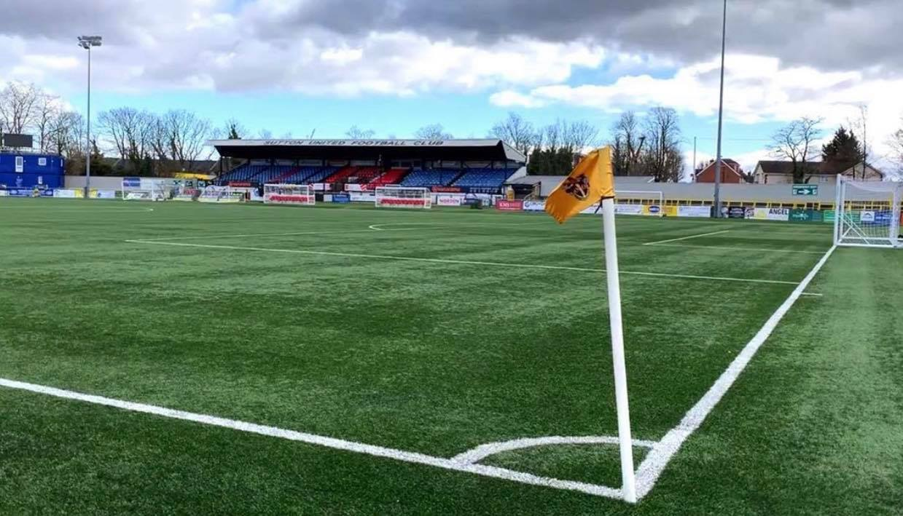
Venue 1: Sutton United FC, Gander Green Lane, SM1 2EY (3G Facility)

Slide 12
Venue 2: St Catherine's Playing Fields, Grand Drive, Raynes Park, Surrey, SW20 9NA (Grass Facility)

Slide 13
Questions?
If you have any questions regarding our evening/weekend classes or after-school clubs feel free to contact us via the details below.
Jamie Decruz – 07506622818 – Jamie@jdsfootballschool.co.uk

